Slide 1
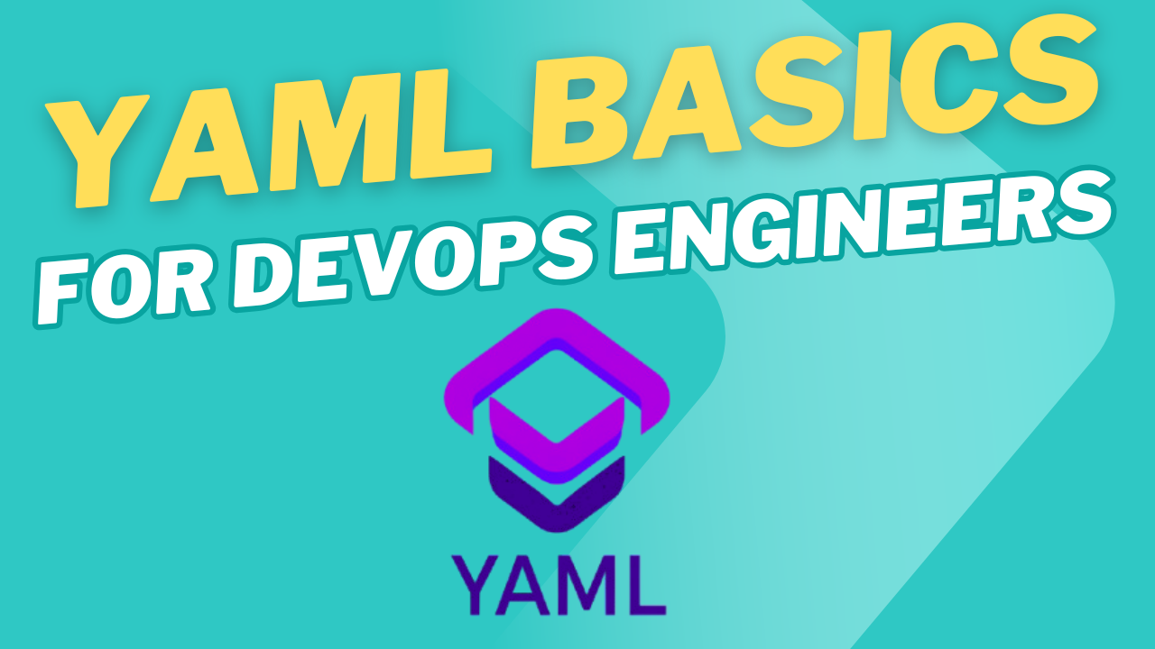

Slide 2
What is YAML?
Imagine you’re making a to-do list. You could use YAML to write it like this:
To-Do:
- Buy groceries
- Walk the dog
- Finish DevOps tutorial
It's a way of organizing data in a structured, readable format. Instead of using curly braces {} like JSON or XML tags, YAML uses indentation and dashes."

Slide 3
Why Do DevOps Engineers Use YAML?
Easy to read
Lightweight and simple
Human-friendly compared to JSON or XML
For example, in Kubernetes, we define resources using YAML. Here's a simple pod configuration:
apiVersion: v1
kind: Pod
metadata:
name: web-pod
spec:
containers:
- name: web-container
image: nginx:latest

Slide 4
YAML Basics You Must Know
Indentation Matters: YAML uses spaces, not tabs. Wrong indentation can break your config
For example, in Kubernetes, we define resources using YAML. Here's a simple pod configuration:
apiVersion: v1
kind: Pod
metadata:
name: web-pod
spec:
containers:
- name: web-container
image: nginx:latest

Slide 5
YAML Basics You Must Know (contd.)
Key-Value Pairs: This is used to keep data in a key-value format.
For example: my-tutorials-data.yaml
platform: YouTube
name: Tech Apricate
domain: devops
Dictionary: This is used to keep data in a key-value format but for a specific item and for different properties of each element. Here, order does not matter.
For example: my-tutorials-data.yaml
videos:
platform: YouTube
name: Tech Apricate
domain: devops

Slide 6
YAML Basics You Must Know (contd2.)
Lists or arrays: You can create a list of items, also called array. Here, order matters.
For example: devopstools.yaml
DevOpsTools:
- Docker
- Kubernetes
- Terraform

Slide 7
YAML Basics You Must Know (contd3.)
Nested structures in yaml: You can nest data using indentation.
For example: bhavukcv.yaml
user:
name: Bhavuk
role: DevOps Engineer
skills:
- Kubernetes
- CI/CD
- Monitoring

